Slide 1

Design and Implementation of a Food Ordering App
Name: FAMATTA MENEKON & Ishmael borde kwoffie
MOBILE DEVELOPMENT project

Slide 2
PROJECT IDEA
The idea is to create a mobile ordering food app that will enble student choose the restaurant of their choice, scan the menu items, choose an item and finnally choose for pick or delivery. payment is then administered by paying with a credit card or mobile money transfer .

Slide 3
PROBLEM STATEMENT
Most students of regent university get to class late especially after break due to lack of food in and around the campus. The manual method of going to their local food sales outlets to purchase food is becoming obsolete and more tasking. Food can be ordered through the internet and payment made without going to the restaurant or the food vendor. Hence we are introducing the “Famfood’’ mobile app.

Slide 4
Proposed Solution
FamFood will be the name of the system or the mobile app
Famfood will connect food vendors to Regent Students
Famfood will provide delivery services to the students thereby creating convenience.
A convenient payment platform which is convenient for both vendors and payees.

Slide 5
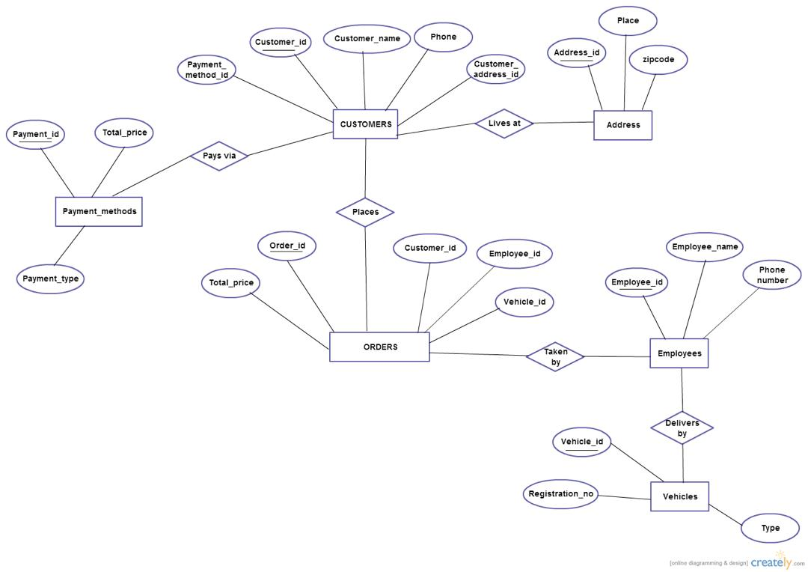
Design or Prototype

Slide 6
Implementation Method
The hompage of the app will design using adobe xd
the product and services will be provide for customers with different categories of available products.
the coding will be do using sublime text and visual studio code

Slide 7
Anticipated Results
so Famfood is the solution for students to order food in and around compus at their own convenience with ease.

Slide 8
Schedules
- First Phase :
User Interface Design
Second Phase :
Prototyping of User Interface and process flow
coding

Slide 9
Conclusion

Slide 10
Your best quote that reflects your approach… “It’s one small step for man, one giant leap for mankind.”
- Neil Armstrong

